Slide 1
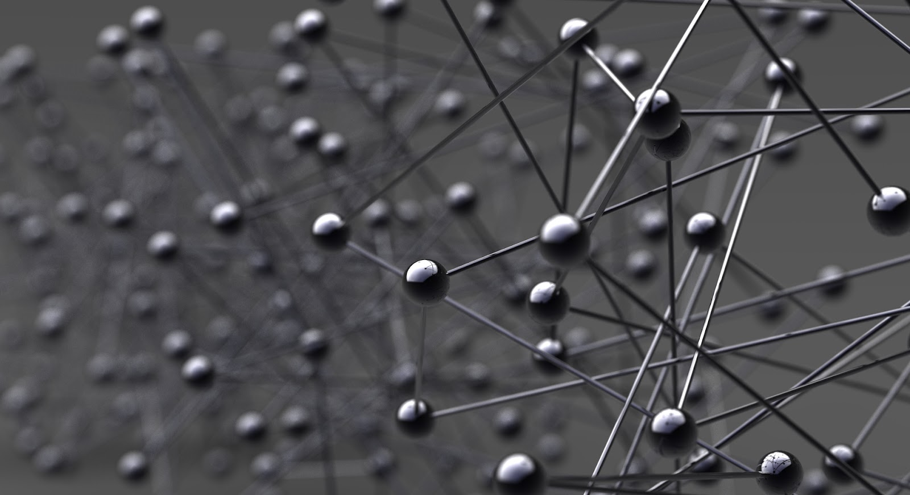
Fourier Analysis of Stochastic Sampling For Assessing Bias and Variance in Integration
Kartic Subr, Jan Kautz University College London

Slide 2
great sampling papers

Slide 3
Spectral analysis of sampling must be IMPORTANT!
Notes:
So, we want to compute the integral of f(x) (shown in yellow). What if f(x) was discretized and stored in an array?
http://www.sciweavers.org/free-online-latex-equation-editor

Slide 4
BUT WHY?
Notes:
So, we want to compute the integral of f(x) (shown in yellow). What if f(x) was discretized and stored in an array?
http://www.sciweavers.org/free-online-latex-equation-editor

Slide 5
numerical integration, you must try
Notes:
So, we want to compute the integral of f(x) (shown in yellow). What if f(x) was discretized and stored in an array?
http://www.sciweavers.org/free-online-latex-equation-editor

Slide 6
assessing quality: eg. rendering
Shiny ball in motion
Shiny ball, out of focus
…
pixel
multi-dim integral
Notes:
So, we want to compute the integral of f(x) (shown in yellow). What if f(x) was discretized and stored in an array?
http://www.sciweavers.org/free-online-latex-equation-editor

Slide 7
variance and bias
High variance
High bias
Notes:
So, we want to compute the integral of f(x) (shown in yellow). What if f(x) was discretized and stored in an array?
http://www.sciweavers.org/free-online-latex-equation-editor

Slide 8
bias and variance
predict as a function of sampling strategy and integrand
High variance
High bias
Notes:
So, we want to compute the integral of f(x) (shown in yellow). What if f(x) was discretized and stored in an array?
http://www.sciweavers.org/free-online-latex-equation-editor

Slide 9
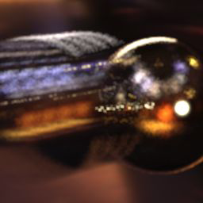
variance-bias trade-off
High variance
High bias
analysis is non-trivial
Notes:
So, we want to compute the integral of f(x) (shown in yellow). What if f(x) was discretized and stored in an array?
http://www.sciweavers.org/free-online-latex-equation-editor

Slide 10
Abstracting away the application…
0
Notes:
So, we want to compute the integral of f(x) (shown in yellow). What if f(x) was discretized and stored in an array?
http://www.sciweavers.org/free-online-latex-equation-editor

Slide 11
numerical integration implies sampling
(N samples)
sampled integrand
0
Notes:
The blue bars show the regularly sampled function.

Slide 12
numerical integration implies sampling
sampled integrand
0
Notes:
And the integral can easily be estimated as the average of the sampled integrand. But how good is this estimate?
http://www.sciweavers.org/free-online-latex-equation-editor

Slide 13
the sampling function
integrand
sampled integrand
sampling function
multiply
Notes:
What I called the sampled integrand is simply the product of the function and the sampling function, in this case a regular grid, or a piece of the Dirac comb or Shah function.
http://www.sciweavers.org/free-online-latex-equation-editor

Slide 14
sampling func. decides integration quality
integrand
sampled function
sampling function
multiply
Notes:
It turns out, that this sampling function is vital in deciding the quality of numerical integration. There are two fundamental ways to improve this sampling function.

Slide 15
strategies to improve estimators
1. modify weights
eg. quadrature rules
Notes:
First, the weights or contributions of the samples may be varied. eg. Trapezoidal or Simpson’s rule.

Slide 16
strategies to improve estimators
1. modify weights
2. modify locations
eg. quadrature rules
eg. importance sampling
Notes:
Also, the positions of samples may be modified. Either they could be sampled according to some distribution or they could be arranged with constraints (such as minimal distance ala Poisson disk sampling). Obviously, combinations of the two are possible. But which of these is more desirable? The machinery required to analyse the different methods is different.

Slide 17
abstract away strategy: use Fourier domain
1. modify weights
2. modify locations
analyse sampling function in Fourier domain
eg. quadrature rules
Notes:
To abstract away these approaches, we analyse the estimators based on the signature of the sampling function in the Fourier domain. eg. This plot shows the amplitude (yellow) and phase (blue) of the sampling signal.

Slide 18
abstract away strategy: use Fourier domain
1. modify weights
2. modify locations
sampling function in the Fourier domain
amplitude (sampling spectrum)
eg. quadrature rules
a. Distribution eg. importance sampling)
frequency
phase (sampling spectrum)
Notes:
To abstract away these approaches, we analyse the estimators based on the signature of the sampling function in the Fourier domain. eg. This plot shows the amplitude (yellow) and phase (blue) of the sampling signal.

Slide 19
stochastic sampling & instances of spectra
Instances of sampling functions
Instances of sampling spectra
Sampler
(Strategy 1)
draw
Fourier
transform
Notes:
Remember that each instance of samples from the sampler produces a different sampling spectrum. Now given the many instances of sampling spectra from two different sampling strategies …

Slide 20
assessing estimators using sampling spectra
Instances of sampling functions
Instances of sampling spectra
Sampler
(Strategy 1)
Which strategy is better? Metric?
Sampler
(Strategy 2)
Notes:
the question we address is how we can compare the strategies, for use in numerical integration. But what is the basis of comparison?

Slide 21
accuracy (bias) and precision (variance)
Estimator 2 has lower bias but higher variance
reference
frequency
Estimator 1
Estimator 2
estimated value (bins)
Notes:
Given two estimators, we can now compare their respective biases and variances. But can we do such comparisons predictively?

Slide 22
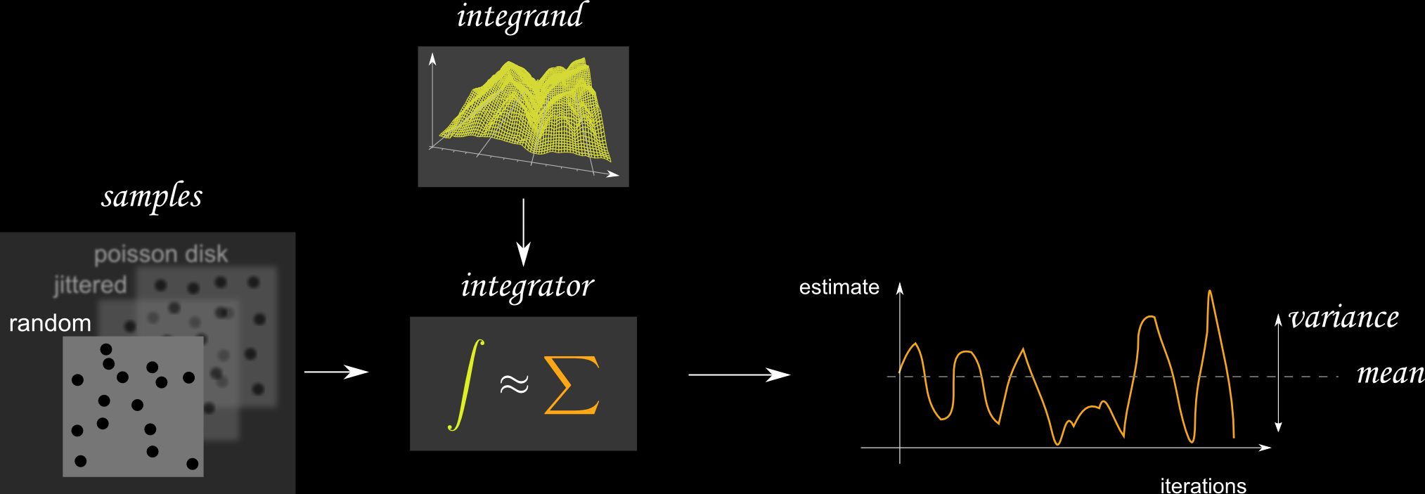
overview

Slide 23
related work
Monte Carlo rendering
Monte Carlo
sampling
spectral analysis
of integration
signal processing
assessing sampling patterns
Notes:
There are several classes of work that are relevant. For this talk, I will briefly describe three of them.

Slide 24
stochastic jitter: undesirable but unavoidable
Jitter [Balakrishnan1962]
Point processes [Bartlett 1964]
Impulse processes [Leneman 1966]
Shot noise [Bremaud et al. 2003]
signal processing
Notes:
There has been work in the signal processing community on analysing point processes, impulse processes and jittered signals. There are two fundamental differences. First, they are mostly concerned with reconstruction, not integration. And second, to them, jitter is unintentional and undesirable but unavoidable.

Slide 25
we assess based on estimator bias and variance
Point statistics [Ripley 1977]
Frequency analysis [Dippe&Wold 85, Cook 86, Mitchell 91]
Discrepancy [Shirley 91]
Statistical hypotheses [Subr&Arvo 2007]
Others [Wei&Wang 11,Oztireli&Gross 12]
assessing sampling patterns
Notes:
In computer graphics, there have been numerous works on assessing point statistics and sampling patterns --- both for reconstruction as well as integration. Some of them focus on modifying weights, some on the sampling distribution and others on the arrangement of samples. We abstract away these choices and directly derive bias and variance in terms of the sampling spectrum’s statistics.

Slide 26
recent and most relevant
spectral analysis
of integration
numerical integration schemes [Luchini 1994; Durand 2011]
errors in visibility integration [Ramamoorthi et al. 12]
Notes:
More recently, there have been analyses of Monte Carlo integration in the Fourier domain. These are most relevant to our work

Slide 27
recent and most relevant
we derive estimator bias and variance in closed form
we consider sampling spectrum’s phase
spectral analysis
of integration
numerical integration schemes [Luchini 1994; Durand 2011]
errors in visibility integration [Ramamoorthi et al. 12]
Notes:
. What distinguishes our work from theirs is that we derive explicit equations for the bias and variance of integrators and that we do not completely ignore phase.

Slide 28
Intuition
(now)
Formalism
(paper)
Notes:
Let us look at the intuition behind our Fourier-domain analysis of integrators that use stochastic sampling.

Slide 29
sampling function = sum of Dirac deltas
+
+
+
Notes:
Any unweighted, sampling function can be expressed as the sum of impulses (or Dirac delta functions).

Slide 30
Review: in the Fourier domain …
Fourier transform
Dirac delta
Frequency
Imaginary
amplitude
phase
Real
primal
Fourier
Complex plane
Notes:
The Fourier transform of a Dirac delta function is a constant (amplitude) with a phase that is linear in frequency (before the modulo 2pi)

Slide 31
Review: in the Fourier domain …
Fourier transform
Dirac delta
Frequency
Imaginary
Imaginary
Real
Real
primal
Fourier
Complex plane
Complex plane
Notes:
The Fourier transform of a Dirac delta function is a constant (amplitude) with a phase that is linear in frequency (before the modulo 2pi)

Slide 32
amplitude spectrum is not flat
Fourier transform
=
=
+
+
+
+
+
+
primal
Fourier
Notes:
The sampling spectrum is therefore the sum of several spectra with constant amplitudes. How does this produce non-constant sampling spectra?

Slide 33
sample contributions at a given frequency
1
2
3
4
5
At a given frequency
sampling function
Imaginary
3
5
1
Real
4
2
Complex plane
Notes:
Now imagine adding more impulses. In this case, the five spikes cause five samples on the dotted circle in the complex plane.

Slide 34
the sampling spectrum at a given frequency
sampling spectrum
Complex plane
given frequency
3
5
centroid
1
4
2
Notes:
Due to the linearity of the Fourier transform, the vector sum of these samples (or the centroid) is the resulting sampling spectrum, sliced at a given frequency. The amplitude spectrum is the distance of the centroid to the Origin and the phase describes the angular offset from the real axis.

Slide 35
the sampling spectrum at a given frequency
sampling spectrum instances
expected centroid
centroid variance
given frequency
Notes:
Over multiple instances of the sampling spectrum, the location of the centroid has an expected value and a variance (or 2D covariance).

Slide 36
expected sampling spectrum and variance
expected amplitude of sampling spectrum
variance of sampling spectrum
DC
frequency
Notes:
Here, the expected amplitude spectrum is shown with a yellow line and the variance (at each frequency) is denoted using an orange blur.

Slide 37
intuition: sampling spectrum’s phase is key
without it, expected amplitude = 1!
for unweighted samples, regardless of distribution
cannot expect to know integrand’s phase
amplitude + phase implies we know integrand!
Notes:
In summary, we have seen that the phase of the sampling spectrum encodes vital information. Yet, we cannot expect to know the phase of the integrand.

Slide 38
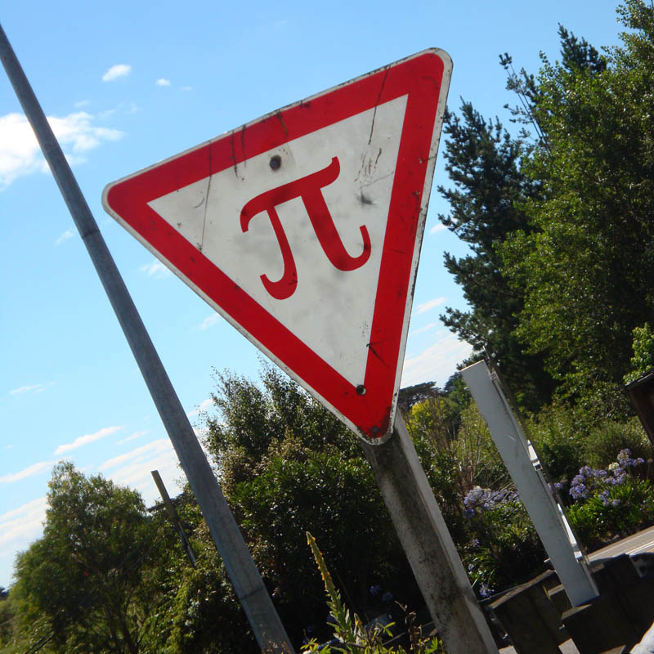
Theoretical results
Notes:
I shall now present the results of our analysis, and refer you to the paper for their derivations.

Slide 39
Result 1: estimator bias
sampling spectrum
integrand’s spectrum
bias
S
f
Implications
S non zero only at 0 freq. (pure DC) => unbiased estimator
<S> complementary to f keeps bias low
What about phase?
reference
frequency variable
inner product
Notes:
The bias of estimators is given by the difference between the reference value and the inner product of the sampling and integrand spectra. Since the integration includes omega=0, the bias can be seen as the inner product at all points except zero.

Slide 40
Result 1: estimator bias
bias
Implications
S = pure DC => unbiased estimator
S complementary to f keeps bias low
What about phase?
Notes:
If the sampling spectrum contains no energy at non-zero frequencies, then the resulting estimator is unbiased. If that is not the case, then the equation suggests that the expected sampling spectrum must be as close to orthogonal as possible, to the integrand’s spectrum. But remember that it is impractical to expect knowledge of the full integrand spectrum.

Slide 41
expanded expression for bias
bias
Notes:
Writing out the bias in terms of amplitudes and phases, we get this. Hiding the ugly notation

Slide 42
expanded expression for bias
amplitude
bias
S
f
S
f
phase
reference

Slide 43
omitting phase for conservative bias prediction
amplitude
bias
S
f
S
f
phase
reference
Notes:
and ignoring the phase component, we get a conservative estimate. that only depends on the expected sampling spectrum. Remember that the amplitude of the expected sampling spectrum encodes phase of the different instances, just not the phase of the result.

Slide 44
new measure: ampl of expected sampling spectrum
ours
periodogram
Notes:
We propose a new criterion for assessing stochastic sampling strategies used in integrators. The amplitude of the expected spectrum. As you can see, it is less conservative than the periodogram.

Slide 45
Result 2: estimator variance
sampling spectrum
integrand’s power spectrum
|| f ||²
variance
S
inner product
frequency variable
Notes:
We derived, in the paper, that the variance of the integrator is an inner product of the variance of the sampling spectrum and the power spectrum of the integrand.

Slide 46
the equations say …
Keep energy low at frequencies in sampling spectrum
Where integrand has high energy
Notes:
So two things to keep in mind: First, keep the amplitude of the expected spectrum low, at frequencies where the integrand contains high energy. Second, keep the variance of the sampling spectrum low at these frequencies to reduce variance.

Slide 47
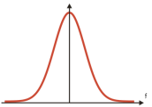
case study: Gaussian jittered sampling
Notes:
We used these relationships to assess a new variant of jittered sampling. The algorithm is simple. Jitter each ball on a grid using a zero-centered Gaussian-distributed random variable. +++ You get this. Why is this good?

Slide 48
case study: Gaussian jittered sampling

Slide 49
1D Gaussian jitter
jitter using iid
Gaussian distributed
1D random variables
samples
Notes:
To find out, we analyzed the 1D version of Gaussian jitter. Each ball on the regular 1D grid is perturbed using iid Gaussian distributed rv’s

Slide 50
1D Gaussian jitter in the Fourier domain
Imaginary
Complex plane
Fourier transformed
samples at an arbitrary
frequency
centroid
Jitter in position
manifests as
phase jitter
real
Notes:
In the Fourier domain, each ball appears with a different phase, and the perturbations manifest as jitter in phases. We derived second order approximations of the expected location and variance of the centroid.

Slide 51
derived Gaussian jitter properties
any starting configuration
does not introduce bias
variance-bias tradeoff
Notes:
We found that, the jitter could be applied on any set of samples. If the original set yields an unbiased estim, then the resulting set also yields an unbiased estimator. If it was biased, then the width of the Gaussian can be used to trade-off bias for variance. The proofs and equations for these are in the paper.

Slide 52
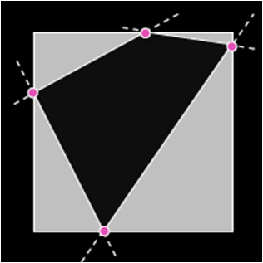
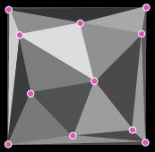
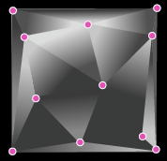
Testing integration using Gaussian jitter
random points
binary function
p/w constant function
p/w linear function
Notes:
We experimented by integrating three types of functions. The pink circles were generated randomly and measurements were taken over several iterations of each class. The trends were similar for each class. So we only show one here. Refer to the paper for the full data.

Slide 53
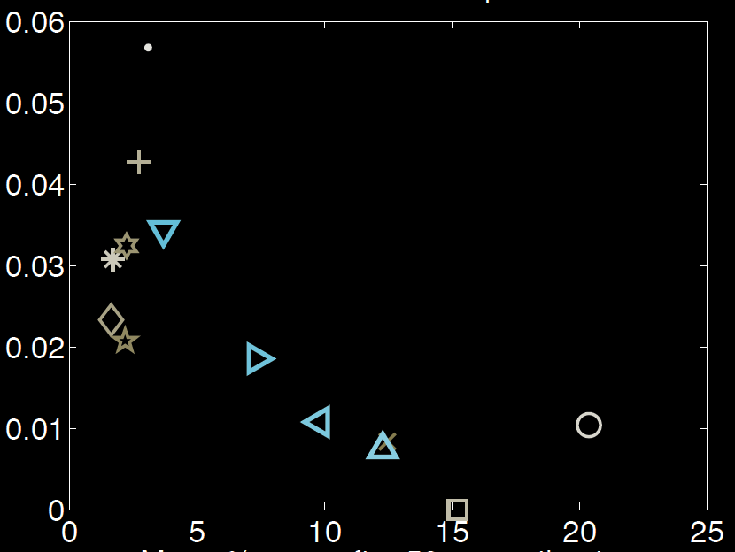
bias-variance trade-off using Gaussian jitter
random
variance
Gaussian jitter
low-discrepancy
Box jitter
Poisson disk
grid
bias
Notes:
First, we plotted the various estimators, each using a different sampling strategy, over the space of variance vs bias. +++ We see that Gaussian jitter with different parameter settings allows a trade-off. +++ Random sampling is low bias but high variance. +++ The regular grid yields a biased, but zero-variance estimator. +++ And other strategies are scattered over the space. Note that box-jitter is close to Gaussian jitter. To verify the benefit of GJ, we then looked at convergence.

Slide 54
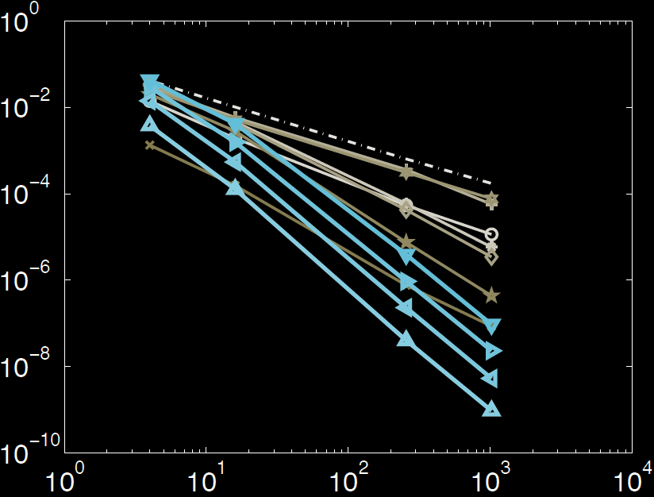
Gaussian jitter converges rapidly
Random:
Slope = -1
O(1/N)
log-variance
Poisson disk
low-discrepancy
Box jitter
Gaussian jitter
Log-number of primary estimates
Notes:
As samples are increased, X-axis, the variance falls. On a log-log plot, the slope of the curve is the convergence. As expected, random sampling yields a convergence of 1/N. We found that Gaussian jitter converged more rapidly than all other methods, in all our experiments.

Slide 55
Conclusion: Studied sampling spectrum
sampling
spectrum
sampling function
integrand
integrand
spectrum
Notes:
To conclude, we studied the bias and variance of integrators in terms of the sampling spectrum and the integrand’s spectrum.

Slide 56
Conclusion: bias
bias depends on E( ) .
sampling
spectrum
sampling function
integrand
integrand
spectrum
Notes:
we derived that the bias is inner product of the expected sampling spectrum and the integrand’s spectrum.

Slide 57
Conclusion: variance
bias depends on E( ) .
sampling
spectrum
sampling function
integrand
2
variance is V( ) .
integrand
spectrum
Notes:
and that the variance is the inner product of the variance of the sampling spectrum and the power spectrum of the integrand. Then we used this theory to analyze Gaussian jittered sampling.

Slide 58
Acknowledgements
Notes:
I thank the funding body and Fredo Durand, Sylvain Paris and Cyril Soler for valuable discussions and proof-reading. Also thanks to the anonymous SIGGRAPH reviewers.

Slide 59
Take-home messages
3
5
No energy in sampling spectrum
at frequencies where
integrand has high energy
1
4
2
relative phase is key
Ideal sampling spectrum
Notes:
So, we want to compute the integral of f(x) (shown in yellow). What if f(x) was discretized and stored in an array?
http://www.sciweavers.org/free-online-latex-equation-editor

Slide 60
Questions?
http://www.wordle.net/show/wrdl/6890169/FMCSIG13

Slide 61
Sorry, what? Handling finite domain?
Integrand = integrand * box

Slide 62
conclusion

Slide 63
Fourier Analysis of Stochastic Sampling Strategies For Assessing Bias and Variance in Integration
Kartic Subr , Jan Kautz
University College London

Slide 67
Theory

Slide 68
a simple estimator
Notes:
Show samples, show integrand. Take them into the Fourier domain. Show spectra

Slide 69
the estimator in the Fourier domain

Slide 70
sampling error accumulates as DC

Slide 71
summary: the quantities involved
integrand

Slide 72
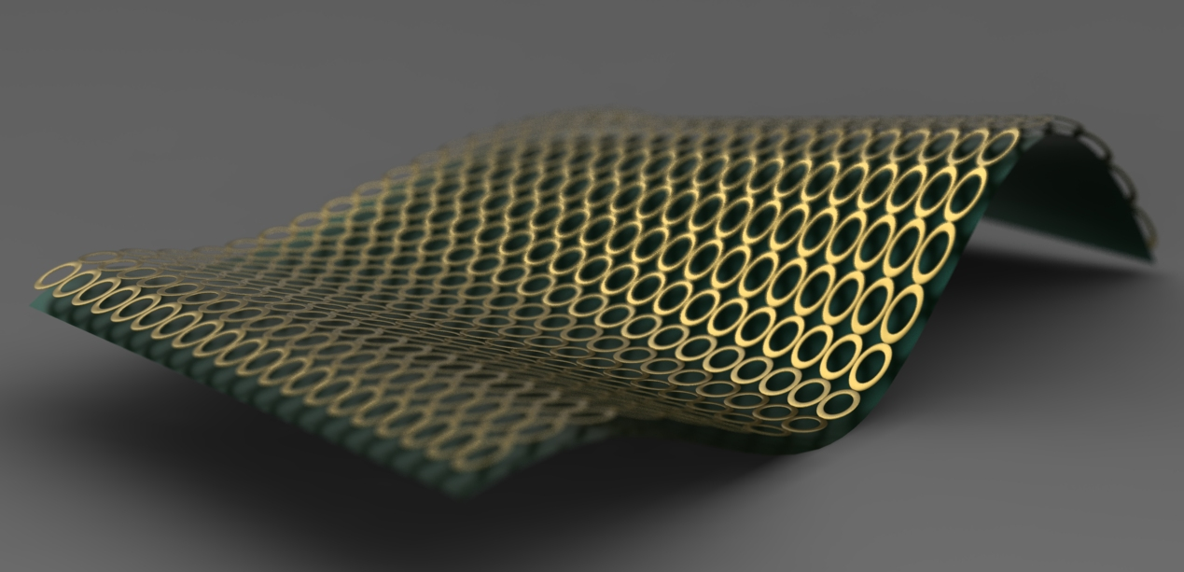
image reconstruction: related work
sample green surface at any (X,Y) location, reconstruct at circle centers
radiance
actual
radiance
X
pixel footprint
Y
Notes:
Applications: Rendering, geometry, animation, etc. In this paper we abstract away the application.

Slide 73
related work
signal processing
Jitter [Balakrishnan1962]
Point processes [Bartlett 1964]
Impulse processes [Leneman 1966]
Shot noise [Bremaud et al. 2003]
Notes:
Signal processing (mostly reconstruction), Deterministic schemes (Simpson’s rule, etc), Stochastic schemes (MC sampling, QMC sampling)

Slide 74
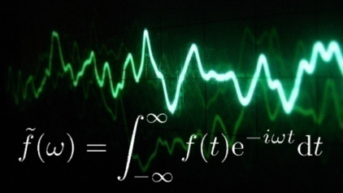
related work
assessing sampling patterns
Point statistics [Ripley 1977]
Frequency analysis [Dippe&Wold 85, Cook 86, Mitchell 91]
Discrepancy [Shirley 91]
Statistical hypotheses [Subr&Arvo 2007]
Others [Wei&Wang 11,Oztireli&Gross 12]
signal processing
Jitter [Balakrishnan1962]
Point processes [Bartlett 1964]
Impulse processes [Leneman 1966]
Shot noise [Bremaud et al. 2003]
spectral analysis of numerical integration
numerical integration schemes [Luchini 1994; Durand 2011]
errors in visibility integration [Ramamoorthi et al. 12]
Notes:
Signal processing (mostly reconstruction), Deterministic schemes (Simpson’s rule, etc), Stochastic schemes (MC sampling, QMC sampling)

Slide 75
reconstruct image at pixel centers
using radiance samples at sparse (X,Y) locations
radiance
actual
radiance
X
pixel footprint
Y
Notes:
… we would like to compute the values at the centers of the circles using values of the green surface given at arbitrary locations.

Slide 76
Image reconstruction: well studied problem
radiance
actual
radiance
X
pixel footprint
Y
Notes:
Of course, this problem has received a lot of attention, and there are numerous analyses.

Slide 77
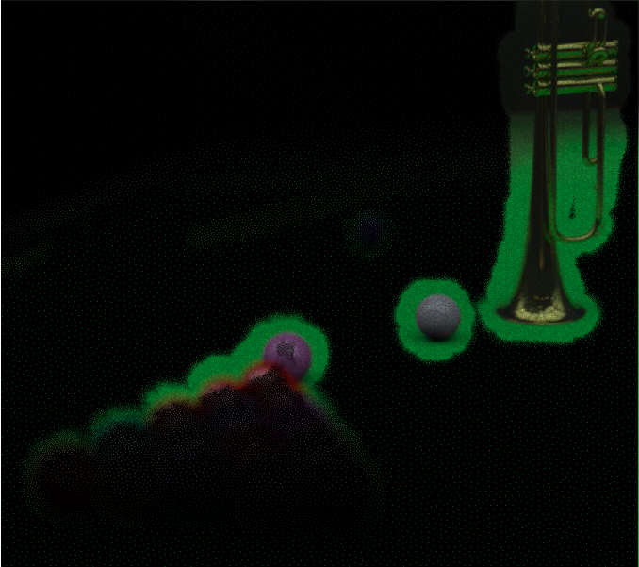
image reconstruction problem
5D samples: space + angle + time
image from [Soler et al 09]

Slide 78
what if radiance samples are approximate?
radiance
2D space
pixel
variance
Notes:
Most of them assume that the samples of the green surface are reliable. What if this is not true?

Slide 79
image reconstruction using integration estimates
pixel area
directions
time
aperture
image from
[Belcour et al 13]
Notes:
For example, in rendering, these values are estimates of integration over multiple domains, each resulting in a different effect.

Slide 80
image reconstruction using integration estimates
pixel area
we focus on integration
directions
time
aperture
image from
[Belcour et al 13]
Notes:
In this paper, our goal is to analyse numerical integration. Recall that a precise estimate not only provides a desirable image, but can also simplify reconstruction. To simplify matters, let’s look at the problem of integration in 1D.

Slide 81
accuracy and precision of estimators
correct value
of integral
expected value
of estimator
frequency
histogram of estimates
estimated value (bins)
Notes:
Here is a red histogram showing the distribution of estimates obtained with several instances of the sampler. Two interesting attributes of this histogram are …

Slide 82
accuracy and precision of estimators
bias
frequency
variance
estimated value (bins)
Notes:
… how far it is from the reference value (yellow line) and how widely the estimates are spread around the expected estimate. That is the bias and the variance.

Slide 83
2 has lower bias but higher variance
reference
frequency
Estimator 1
Estimator 2
estimated value (bins)
Notes:
Given two estimators, we can now compare their respective biases and variances. But can we do such comparisons predictively?

Slide 84
we derive estimator bias and variance
closed form!
sampling spectrum
?
bias
variance
integrand
Notes:
This is exactly the goal of our work. Given the statistics of the sampling function’s spectrum and the integrand, to derive the bias and variance in closed form.

Slide 85
we derive estimator bias and variance
closed form!
sampling spectrum
?
bias
variance
integrand
Notes:
The rest of this talk fixates on

Slide 86
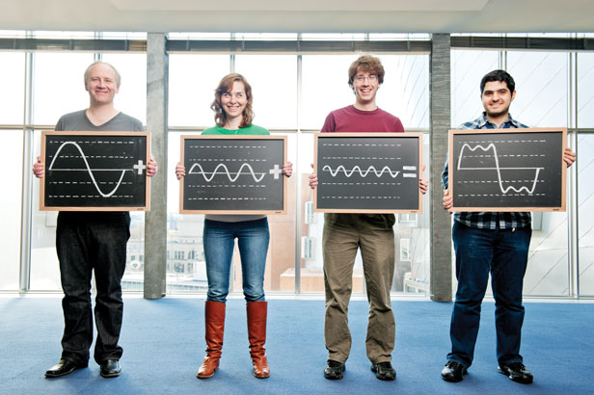
Intuition: non-weighted samples
Notes:
Let us look at the intuition behind our Fourier-domain analysis of integrators that use stochastic sampling.

Slide 87
Review: in the Fourier domain …
Fourier transform
Dirac delta
p
Frequency
Imaginary
amplitude
Real
phase
primal
Fourier
Complex plane
Notes:
The Fourier transform of a Dirac delta function is a constant (amplitude) with a phase that is linear in frequency (before the modulo 2pi)

Slide 88
dissecting the sampling spectrum
Imaginary
Real
Complex plane
Notes:
At different frequencies, the complex number has different phases, but the same amplitude.

Slide 89
Review: in the Fourier domain …
Fourier transform
constant amplitude
Dirac delta
p
phase depends on p
primal
Fourier
Notes:
The Fourier transform of a Dirac delta function is a constant (amplitude) with a phase that is linear in frequency (before the modulo 2pi)

Slide 90
dissecting the sampling spectrum
Imaginary
amplitude
Real
phase
Complex plane
Notes:
Consider a single Dirac delta and its spectrum. Let us slice the spectrum using an orange block and visualize the Fourier transform of the sampling function evaluated at that frequency. The orange circle is this complex number shown in the complex plane.

Slide 91
periodogram is even more conservative
samples
periodogram
(expected power spectrum)
amplitude of expected spectrum
Notes:
Going back to our complex plane visualization, we see that the centroid does account for the relative phases of the samples. The periodogram in this case is not useful, as it is obtained by discarding the relative phases of the gray circles.

Slide 92
Summary of results
for low bias
amplitude of expected sampling spectrum
keep orthogonal to integrand’s Fourier spectrum
for low variance
variance of sampling spectrum
keep orthogonal to integrand’s power spectrum
Notes:
So two things to keep in mind: First, keep the amplitude of the expected spectrum low, at frequencies where the integrand contains high energy. Second, keep the variance of the sampling spectrum low at these frequencies to reduce variance.

Slide 93
Acknowledgements
Royal Society’s Newton International Fellowship
Sylvain Paris, Cyril Soler, Fredo Durand
Anonymous SIGGRAPH reviewers

Slide 94
quantitative experiments

