Slide 1
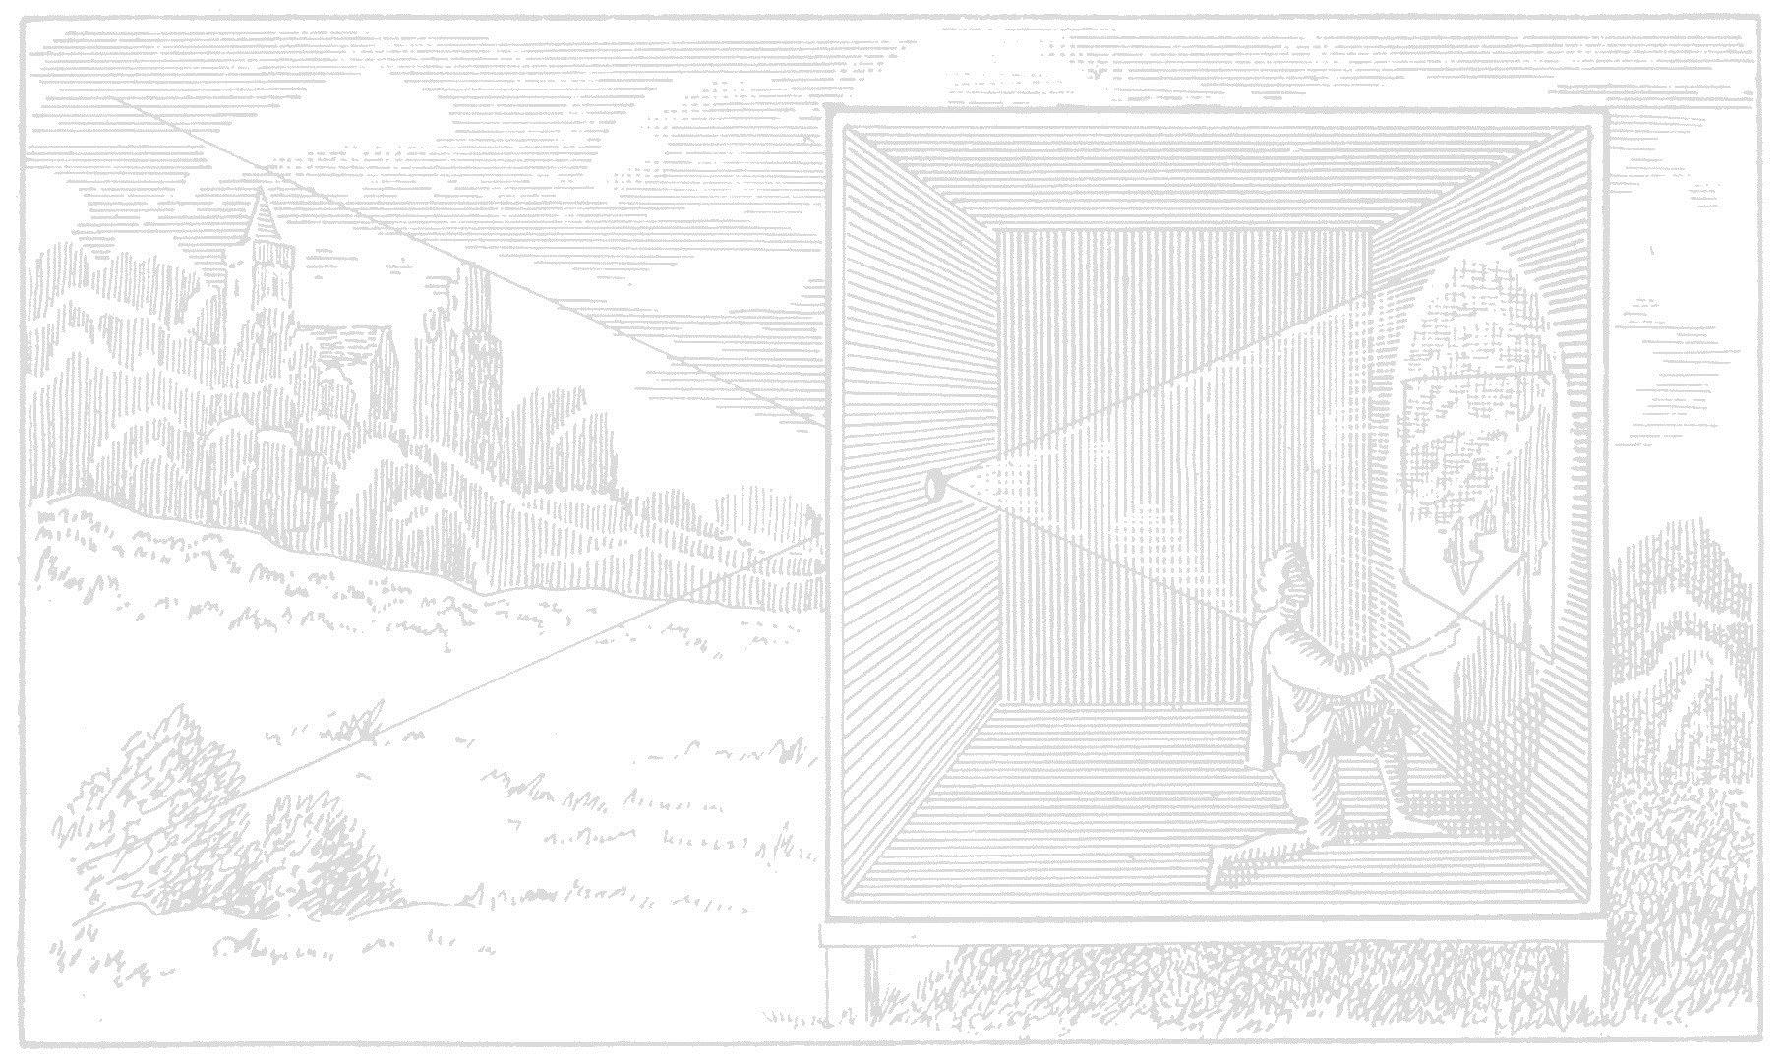
5D COVARIANCE TRACING FOR EFFICIENT DEFOCUS AND MOTION BLUR
Laurent Belcour¹ Cyril Soler² Kartic Subr³ Nicolas Holzschuch² Frédo Durand⁴
¹ Grenoble Université, ² Inria, ³ UC London, ⁴ MIT CSAIL
Notes:
Thank you for the introduction. Thank you all for attending. *click*

Slide 2
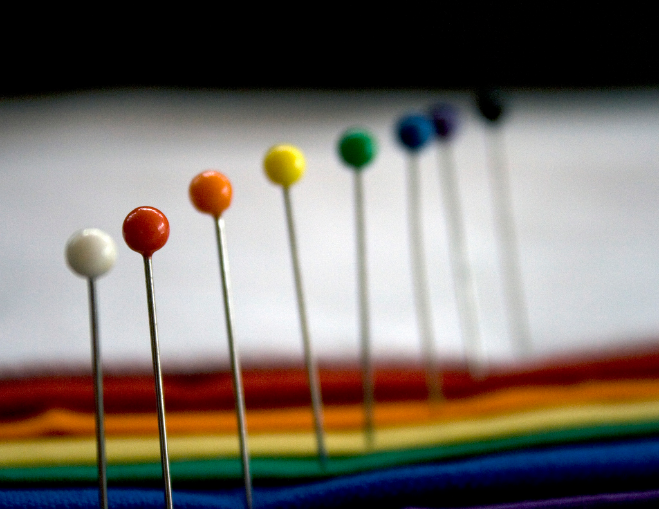
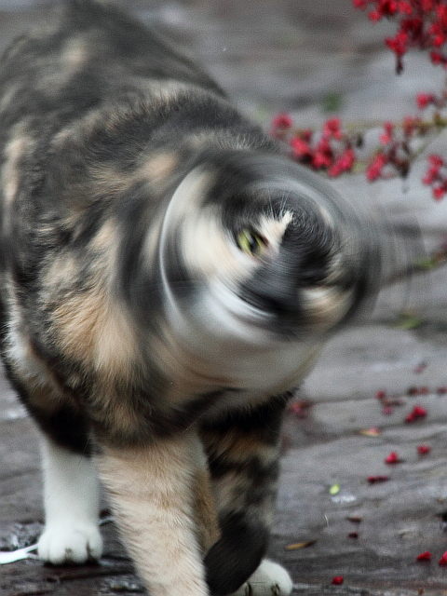
Blur is costly to simulate !
Notes:
In this presentation, I will talk about blur caused by multidimensional integration of glossy BRDFs, lenses and motion. All those effects reduce the local visual complexity of images. *click* While the result is smooth, simulating those effects is very costly as the integration domain is expanding in various dimensions. It results in what we could call a paradox of image synthesis where an image with blur is costlier to simulation than an image without. *click*

Slide 3
Notes:
To overcome this paradoxe, we would like to adapt the simulation effort such that the minimum computation possible is made for rendering smooth effects. *click* In the case of monte carlo rendering, this can be done by adapting the sampling rate to the blur and performing a recontruction of the final image using a filter. *click*

Slide 4
time
integration
space
reconstruction
Notes:
Note that thoses samples lie on the 5D dimensional space of the time space and angle. *click* We need to reconstruct the pixel space but have samples in the composed domain of space, time and lens. Filters are also defined in this high dimensional domain. We show that we can rely on 2D image plane filters to reconstruct the image from 5D samples. *click*

Slide 5
Previous works: a posteriori
Image space methods
[Mitchell 1987], [Overbeck et al. 2009],
[Sen et al. 2011], [Rousselle et al. 2011]
Integration space
[Hachisuka et al. 2008]
Reconstruction
[Lehtinen et al. 2011], [Lehtinen et al. 2012]
Easy to plug
Require already dense sampling
Rely on point samples
Notes:
We separate adaptive sampling methods into two categories based on the way they estimate the blur: The first kind, a-posteriori methods use already drawn samples to estimate the blur. *click* Some methods are working in the image plane, and limit adaptive sampling to the spatial 2D domain. *click* Other methods adapt sampling rates in the full integration space. *click* The temporal light field can also be reconstructed by reprojecting those samples. *click* These methods are usually easy to plug inside existing ray-tracers as they use samples as input. *click* The downsize is that they require enough samples to have a good estimate of the variations of the light-field function. *click* They cannot predict if a region of the light-field space is sufficiently covered by samples. *click*

Slide 6
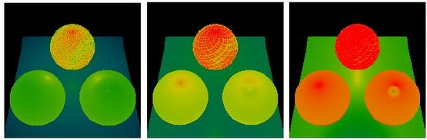
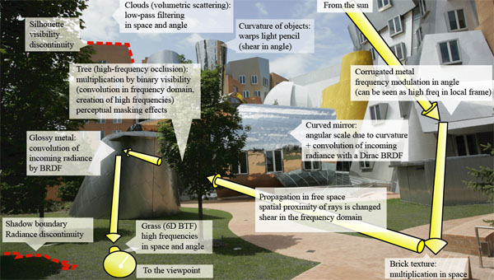
Previous work: a priori
First order analysis [Ramamoorthi et al. 2007]
Frequency analysis [Durand et al. 2005]
Notes:
On the other side, a priori methods predict the variation of radiance before hand. *click* Some methods are predicting the gradient. *click* other methods compute the local fourier transform of it. We belong to the later. *click*

Slide 7
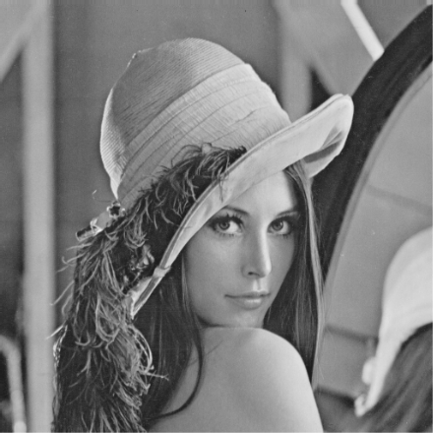
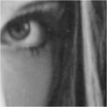
Previous work: a priori
First order analysis [Ramamoorthi et al. 2007]
Frequency analysis [Durand et al. 2005]
zoom
Fourier transform
Notes:
The fourier transform is interesting because it is directly related to the presence of blur in the image. You can see in the zoom of this lena image that low varying region have a fourier transform packed around the origin, while high varying regions are spread in the frequency domain. The goal of frequency based methods is then to estimate the spectrum of radiance around a 5D sample. *click*

Slide 8
Previous work: a priori
Predict full spectrum
Predict bounds
Anisotropic information
Unwieldy
Compact & efficient
Special cases formula
[Soler et al. 2009]
[Egan et al. 2009], [Bagher et al. 2013], [Meha et al. 2012]
None can work with full global illumination!
Notes:
And to do so, you need a representation of the spectrum. *click* Some methods predict the complete spectrum using dense sampling. *click* This is a source of reliable and complete information but is too costly. *click* other methods predict the boundary of the spectrum. This representation is compact and very fast to evaluate. But it requires special case formula such as sheared forms. *click* Both representation are built on a last bounce formulation of light transport and do not extend to global illumination. *click*

Slide 9
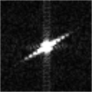
Our idea: 5D Covariance representation
Notes:
We want a representation that is at the same time complete and efficient in term of storage and evaluation. *click* for that we introduce the covariance representation that predicts the orientation and relative spread of the 5D spectrum. *click*

Slide 10
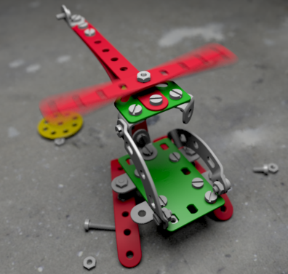
5D Covariance representation
Use second moments
5x5 matrix
Equivalent to Gaussian approx.
Formulate all interactions
Analytical matrix operators
Gaussian approx. for reflection
Nice properties
Symmetry
Additivity
angle (2D)
space (2D)
time
Notes:
this representation is build using the matrix of the second moments of the spectrum. *click* we display it using the equivalent Gaussian, here by compressing some dimensions. *click* The covariance correctly depicts the shape of the spectrum and can predict whether the sprectrum lies in the spatio-temporal domain for sliding motion blur, *click* or in the spatio-angular domain for defocus blur. *click* we show that the covariance can be easily evaluated using analytical matrix operations. When analytical forms are not possible, we use a Gaussian approximation. *click* the covariance as very interesting properties such as symmetry which allows to save storage and additivity which makes it compatible with monte carlo. *click*

Slide 11
Contributions
Unified temporal frequency analysis
Covariance tracing
Adaptive sampling & reconstruction algorithm
Notes:
Our contributions are the following: *click* we introduce a unified frequency analysis of temporal light fields. *click* this analysis is used to build a generic representation of the spectrum, the covariance matrix. We also introduce covariance tracing, a new way to produce light paths with more information. *click* we show the use of such representation in an adaptive sampling and reconstruction algorithm. *click*

Slide 12
Our algorithm
Accumulate 5D Covariance
in screen space
Notes:
I will now describe our algorithm. *click* first, we estimate the covariance matrix in the screen by accumulating it. *click*

Slide 13
Our algorithm
Accumulate 5D Covariance
in screen space
angle
Estimate 5D
sampling density
time
angle
time
angle
time
Notes:
The covariance matrix is used to estimate the required number of samples in the temporal light field. *click* this sampling will adapt to sharp features in the 5D integration domain. Less samples will be produced for regions with low variation in time and angle. *click*

Slide 14
Our algorithm
Accumulate 5D Covariance
in screen space
Estimate 5D
sampling density
Estimate 2D reconstruction filters
Notes:
We also estimate the required image space filters to reconstruct the image from the set of 5D samples. *click*

Slide 15
Our algorithm
Accumulate 5D Covariance
in screen space
Estimate 5D
sampling density
Estimate 2D reconstruction filters
Acquire 5D samples
Reconstruct image
Notes:
Finally, we acquire 5D dimensional adaptive samples and reconstruct the image using the 2D filters. This 5D sampling but 2D reconstruction allows to benefit from adaptive sampling the full temporal light field while still have a simple formulation of the reconstruction. *click*

Slide 16
Accumulate 5D Covariance
in screen space
Estimate 5D
sampling density
Estimate 2D reconstruction filters
Acquire 5D samples
Reconstruct image
Notes:
First lets have a look at how we can create covariance information and accumulate in screen space *click*

Slide 17
Covariance tracing
Add information to light paths
Update the covariance along light path
Atomic decomposition for genericity
Notes:
To compute covariance information in screen space, we introduce covariance tracing, *click* a new way to add information to light paths. *click* to obtain the covariance at any point on a light path, we update the covariance representation of the light source spectrum to account for changes along the light path. *click* this is made possible thanks to an atomic decomposition of the interaction of light with matters that allows to handle any light path configuration. *click*

Slide 18
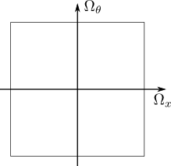
Covariance tracing
Free transport
Free transport
Notes:
We start with the light vertex of the light path. *click* We initate the covariance matrix at this position using the spectrum of the light source. In the remaing of the talk, we will use this 2D representation of the covariance for simplicity *click* the horizontal axis denotes the spatial frequencies *click* the vertical axis denotes the angular frequencies *click* For the case of this diffuse square source, the spectrum will be compacted in the angular region, since the illumination is not varying with respect to angles. And the spectrum will be expanded in the spatial domain since the light source has a finite width *click* We compute the covariance at the next light path vertex. This unoccluded travel of light to the next vertex is modeled with a free transport operator and shears the spectrum in space and angle. It has the same effect on the covariance matrix. *click*

Slide 19
Covariance tracing
Free transport
Reflection
Notes:
The next step is to compute the transformation of the covariance after a reflection with this diffuse wall. *click* Reflection acts mainly as a low pas filter in the angular domain. *click* it results in the following operator where the covariance shrinks in angular dimensions. *click* we continue build our light path *click*

Slide 20
Covariance tracing
Free transport
Free transport
Reflection
Notes:
With the travel to the next hit point. *click* During travel, we must account for local occlusion around the light-path. *click*

Slide 21
Covariance tracing
Free transport
Occlusion
Reflection
Free transport
spatial visibility
Notes:
Such as this grey blocker. Even if the main ray is not occluded, we need to handle occlusion of neigboring rays. *click* This occlusion increase spatial frequency and extend the covariance in spatial dimensions. *click*

Slide 22
Covariance tracing
Free transport
Free transport
Occlusion
Notes:
We continue our transport *click* until the specular reflector *click*

Slide 23
Covariance tracing
Free transport
Reflection
Free transport
Notes:
For the case of pure specular mirror, *click* the brdf preserve angular frequencies. *click* We obtain the following covariance. *click*

Slide 24
Covariance tracing
Free transport
Free transport
Reflection
Notes:
Finaly, *click* we perform the last travel to the eye. *click* and get the final covariance matrix at pixel position. *click*

Slide 25
Just a chain of operators
Free transport
Occlusion
Curvature
Symmetry
BRDF
Lens
Notes:
Building a different light path will involve chaining in a different order *click* the set of operators on the light field spectrum. All those operators can be expressed as simple matrix operations on the covariance matrix. *click*

Slide 26
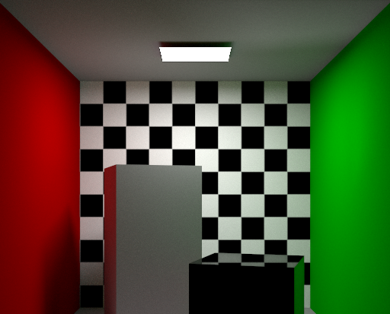
What about motion?
Notes:
Right now, we have not talked about handling moving object in a light path. The operator we defined are only working on the reduce 4x4 covariance matrix of space and angles. Motion affects many operators: *click* of light sources, *click* of occluders, *click* of reflectors, *click* and motion of the eye. To handle motion we could: *click*

Slide 27
We could rewrite all operators…
$$Ω_{t}$$
$$Ω_{t}$$
$$Ω_{t}$$
$$Ω_{t}$$
Occlusion
with moving occluder
Curvature with moving geometry
BRDF with moving reflector
Lens with moving camera
$$Ω_{t}$$
$$Ω_{t}$$
$$Ω_{t}$$
$$Ω_{t}$$
Notes:
Rewritte all the operators that deal with moving objects to handle the full 5x5 matrix. This would be too burdensome, would make harder to incorporate new operators, and augment the chances of bugs in the implementation. *click*

Slide 28
We will not rewrite all operators!
Motion
Occlusion
Curvature
BRDF
Lens
Inverse Motion
Notes:
Instead, we keep the static 4x4 operators and handle time by performing the static analysis in the local frame of the object. *click* This is done by adding one operator that will change the coordinates of analysis from the global static frame to the moving local frame, and the inverse operator to go back from the moving local frame to the static global frame. *click*

Slide 29
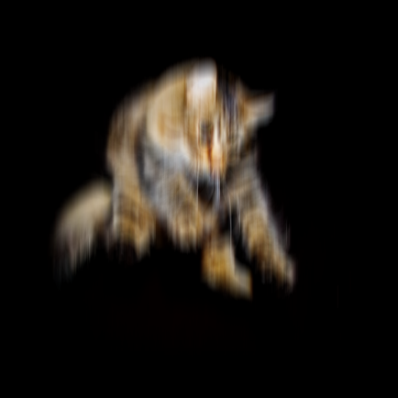
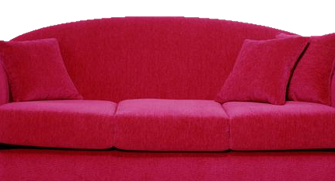
Motion operator
angle
space
time
Reflection with moving reflector
angle
space
time
Notes:
To illustrate this, let us analyze the reflection of light on this falling cat. The resulting operator is a reflection along the angular domains but motion affects the space and time component of the covariance. *click* But in our case, we decompose this operator into *click*

Slide 30
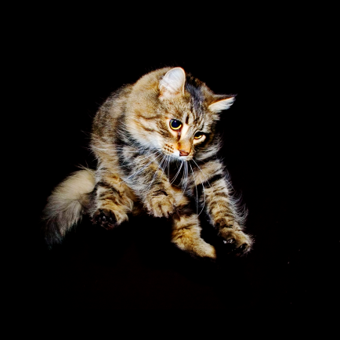
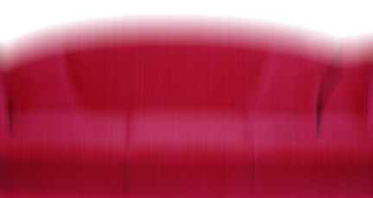
Motion operator
angle
space
time
Motion
Reflection
Notes:
A first transformation that makes the cat static and the world moving. This transformation shears the space/time components of the covariance matrix *click* then a static reflection operator that bandlimits angles. *click*

Slide 31
Motion operator
angle
space
time
Motion
Reflection
Inverse Motion
angle
space
time
Notes:
And the inverse transformation that makes the world static again. Note that this composed operator is completely equivalent to a full reflection with moving reflector operator. It is just decomposed in a way easier to analyze/write/debug. *click*

Slide 32
Accumulate covariance
first light path
second light path
final covariance
Notes:
When multiple light path accumulate on the same pixel, for example is the case of multiple light sources, we need to combine the different covariances. *click* This is done using the additivity of covariance and doing the weighted average of the matrices using the light paths intensity as weight. Note that the covariances need to be aligned in the same coordinate system. More details can be found in the paper. *click*

Slide 33
Accumulate 5D Covariance
in screen space
Estimate 5D
sampling density
Estimate 2D reconstruction filters
Acquire 5D samples
Reconstruct image
Notes:
Now lets have a look at how we estimate the required number of adaptive samples for the temporal light field and how we estimate the image space reconstruction filters *click*

Slide 34
Using covariance information
How can we extract bandwidth ?
Using the volume
Determinant of the covariance
How can we estimate the filter ?
Frequency analysis of integration [Durand 2011]
Slicing the equivalent Gaussian
space
$$V$$
space
time
Notes:
The number of samples is inversely proportional to the badnwidth of the fourier transform. *click* we show in the paper that we can estimate it using the volume of the equivalent Gaussian. This quantity is given by the determinant of the covariance matrix. *click* to estimate the filters, we build on the fourier analysis from Durand. The image space filters are estimated using a slice of the 5D equivalent Gaussian. This gives us a 2D Gaussian reconstruction filters correctly blurring motion and defocus. *click*

Slide 35
Accumulate 5D Covariance
in screen space
Estimate 5D
sampling density
Estimate 2D reconstruction filters
Acquire 5D samples
Reconstruct image
Notes:
I won’t detail how we acquire the samples and how we filter them. Please refer to the paper for those details. *click*

Slide 36
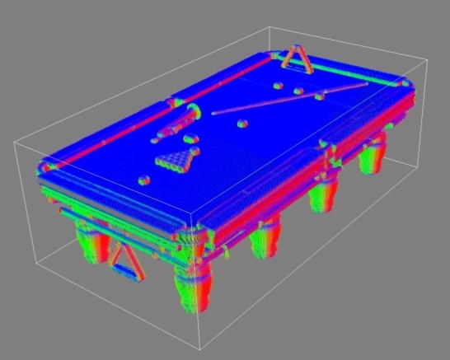
Implementation details: occlusion
Occlusion using a voxelized scene
Use the 3x3 covariance of normals distribution
Evaluate using ray marching
Notes:
Before I go into the results of this method, I will detail how we estimate local occlusion. *click* To estimate occlusion, we use a voxelized version of the scene. *click* Each voxel the 3x3 covariance matrix of the distribtion of normals in a small neighborhood around each voxel center. *click* We ray march in this grid for each light path edge during covariance tracing. *click*

Slide 37
Results: the helicopter
Our algorithm
Equal time Monte-Carlo
Notes:
We analyze the ouputs of our algorithm. For this helicopter scene, we display the resulting filters for various position in the scene. On the top you can see how our filters adapt to defocus for the propeller and the textured background. On the middle you can see how filters respond to highly varying geometry. On the bottom you can see how the filters adapt to soft shadows and in focus geometry. *click* screw *click* propeller *click* cabin. *click*

Slide 38
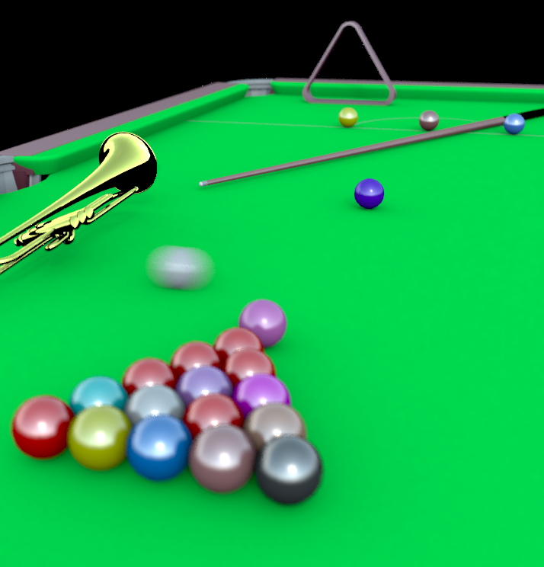
Results: the snooker
defocus blur
motion blur
BRDF blur
Our method
Equal-time Monte Carlo
Notes:
In this snooker result, we demonstrate the ability of covariance tracing to adapt and filter compound of brdf motion and defocus blur. The focal plan is placed at the position of the blue ball. *click*

Slide 39
Results: the snooker
Our method: 25min
Eq. quality Monte Carlo: 2h25min
200 light field samples per pixel
Covariance tracing: 2min 36s
10 covariance per pixel
Reconstruction: 16s
Notes:
Here are some timing for the snooker scene. We achieve the rendering of the snooker scene by reducing by a factor of 5 the time required. The covariance tracing part takes 10% of the total time of the algorithm and the cost of the reconstruction is minimal. *click*
I used 40 light path per light field samples. (voxel grid 200 voxels wide)
(1 sec for 1 light path per pixel for the traditional, 15 sec for 1 covariance light path per pixel) covariance tracing a light path is 15 times slower

Slide 40
Conclusion
Covariance tracing
Generate better light paths
Simple formulation
Unified frequency analysis
Temporal light fields
No special case
Notes:
To summarize, *click* we presented covariance tracing. A new way to increase light paths efficiency as it allows to adapt the sampling rate. It has a simple formulation using chains of operators. (generic / monte carlo friendly). We showed its use in an adaptive sampling an reconstruction algorithm. *click* we introduced a unified frequency analysis of temporal light fields that does not require special cases formulation. This conclude my talk. *click*

Slide 41
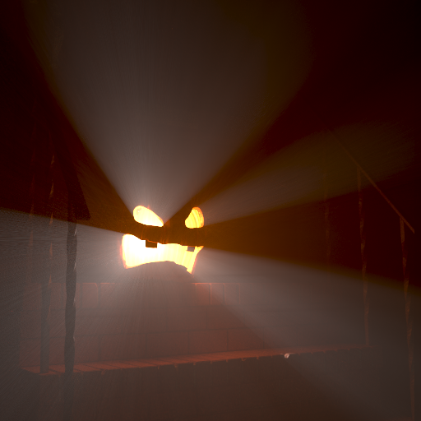
Future work
Tracing covariance has a cost
Mostly due to the local occlusion query
New operators
Participating media
Notes:
The current version of covariance tracing has a non negligeable cost. *click* While tracing covariance will always increase the cost of the light path as it is a tradeoff to obtain a sample with more information, it comes mostly from our local occlusion estimation. We plan to work in reducing this overcost. *click* Also, an interesting direction is the addition of new operators. We already tackled the participating media case, currently submitted to TOG. *click*

Slide 42
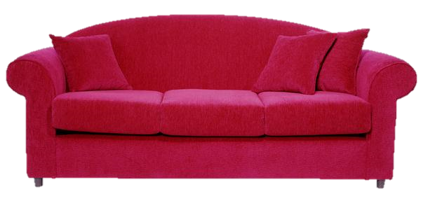
GROUND IS MOVING!
Notes:
Thank you for your attention.

